Slide 1
Welcome to lab!
Santa Ana College
Fall 2025

Slide 2
Lab Expectations
There are not expectations for lab attire in general
If a lab requires more protective equipment I will inform you ahead of time, or provide the PPE
Food and beverages are not allowed during lab.
Being more than 45 minutes may interfere with your ability to participate fully as a member of your group and you might miss quizzes
Each lab exercise consists of three core parts (two will be in class):
Introduction of theory/experiment by the instructor.
Handout with details of procedure, questions you must answer, and potential analysis questions after you have data.
The creation of a “lab report” by your group.

Slide 3
Before you leave the lab exercise
Before you go ensure you:
Completed collecting all the data as outlined in the lab exercise handout
Show me your data and get my go ahead to head out.
If you skip this step, and your data had a significant mistake, this can impact your grade.
Shared the data in a way that every member of your group can access outside of lab
Re-organize the lab equipment (but leave it at your group’s table)

Slide 4
Lab Reports are a Group Exercise
Each lab there will be a sign-in sheet for each table.
Make sure you sign-in and turn this in before you leave.
Each person should decide to be responsible for:
Data (up to 2 people)
Analysis (includes calculations, up to 2 people)
Conclusions (up to 2 people)
After lab, but before the next day, I will move you into the groups from the sign-in sheets that were returned to me.
Ensure only one assignment from your group gets turned in on Canvas.
10 points are group grade, 5 points are for your individual section (data, analysis, or conclusions).
If you miss a lab you will be assigned an alternative lab exercise, only if you contact me.
If you miss a lab and do not contact me, you will receive the minimum score.

Slide 5
Lab Reports
Lab reports should be created in a word processor, and not handwritten.
The lab reports should include the following sections:
Your name, the lab exercise name, the name of your lab partners.
Data, tables and graphs (as necessary for the lab)
Calculations
Answers to the questions from the lab handout.
Conclusions

Slide 6
1. Your name, the lab exercise name (see handout), the name of your lab partners.
This should be clear, and on the front page.
It can be a cover page, or it can be just near the top of the first page, but it should be visible, clear, and have all the required information.

Slide 7
2. Data, tables and graphs (as necessary for the lab)
Any data collected in the lab should be presented in clear, readable, and complete formats.
Tables and graphs of data where appropriate should be here.
Any tables and graphs need to be correctly labeled, with correct units.

Slide 8
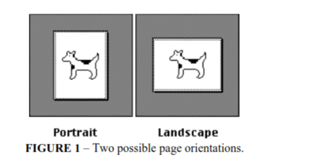
Graphing
There are a few major guidelines for how we grade the graphs in Physics:
1. Turn-in graphs in landscape rather than portrait.

Slide 9
Graphing
There are a few major guidelines for how we grade the graphs in Physics:
This doesn’t always work in Adobe, however, when including a graph in word it should be landscape rather than portrait
1. Turn-in graphs in landscape rather than portrait.

Slide 10
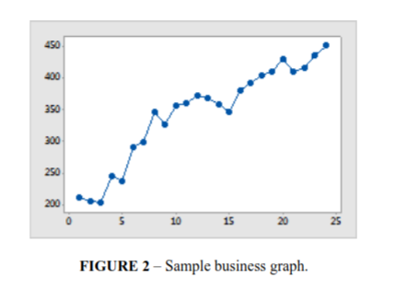
Graphing
2. Title each and every graph.
3. Label the axes of the graph.
4. Unlike the graph to the right, do not connect point-to-point. Scatter plots should have unconnected points for all graphs produced in this lab.
5. Instead of connecting points, we will be using statistical fits. When we use this best fit it is important to display the equation of fit, along with the R-squared value on the graph.

Slide 11
3. Calculations
Any calculations that were necessary for either the lab itself, or answering questions for the lab report should be in this section.
Show every step.
This is the only section that can be written by hand.
If an identical calculation is performed various times, for instance calculating density of various objects using the same formula, you should show this calculation in all of its steps at least once, then you can simply report the rest of the results in a Table of Calculations or Table of Results

Slide 12
4. Answers to the questions from the lab handout.
Answer all the questions from the lab handout.
Use complete sentences.
Reference work from Calculations section where necessary.
Interpret or justify answers using information presented in prior sections of the lab report.
There is no conclusion section, but answers to questions can inform the “conclusions” you draw in the abstract.

Slide 13
5. Conclusion
A conclusion is a comprehensive closing section of your lab report that should have:
Restatement of Purpose: The conclusion begins by briefly restating the main objective or research question of the lab.
Summary of Key Findings: It summarizes the most important results obtained, highlighting patterns or trends without repeating all the data.
Interpretation and Analysis: This section explains what the results mean, whether they support or reject the hypothesis, and how they relate to scientific principles or theory.
Implications and Significance: The conclusion discusses the broader meaning of the findings, including practical applications, contributions to the field, or answers to the original research questions.
Limitations and Future Work: It acknowledges any experimental limitations and suggests areas for future investigation or improvements.
Clarity and Synthesis: A conclusion should be clear and coherent, synthesizing all aspects of the experiment while avoiding introduction of new data or concepts not previously discussed in the report.

